Slide 1
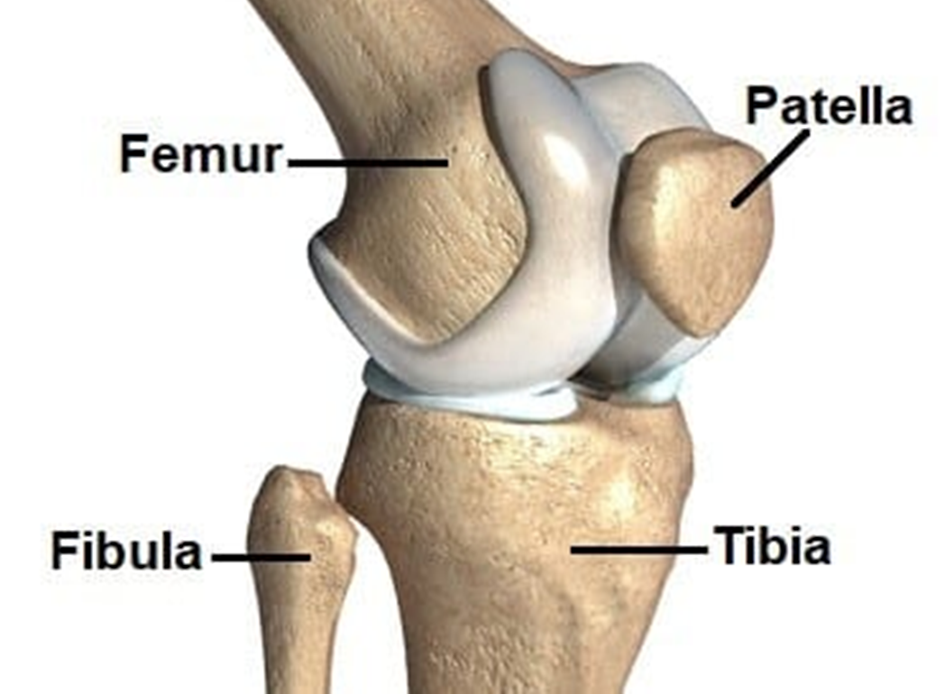
Muscles and Neurovascular Structures around the Knee
Ngozi Onuegbu PhD
PT4050/PT7001

Slide 2
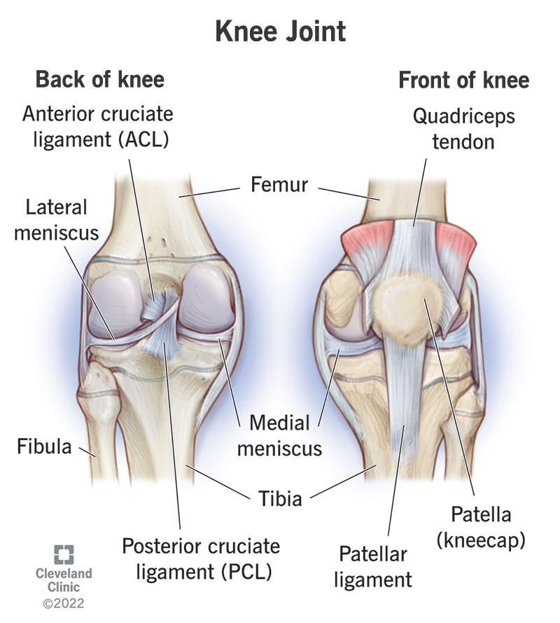
Knee Joint
Type of joint: Hinge joint
Articulating surfaces: Femur, tibia, patella
Functions: Flexion, extension, stability during movement

Slide 3
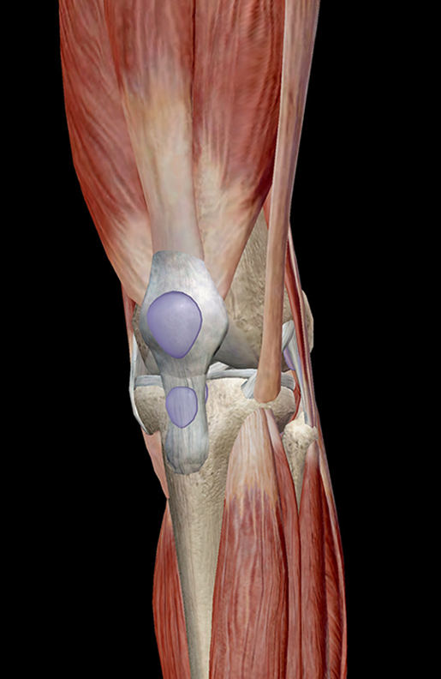
Muscles of the Knee
Flexors:
  Hamstrings (Biceps Femoris, Semitendinosus, Semimembranosus),
  Gastrocnemius
Extensors:
  Quadriceps (Rectus Femoris, Vastus Lateralis, Vastus Medialis, Vastus Intermedius)
Internal Rotators:
  Semitendinosus,
  Semimembranosus,
  Popliteus
External Rotators:
  Biceps Femoris

Slide 4
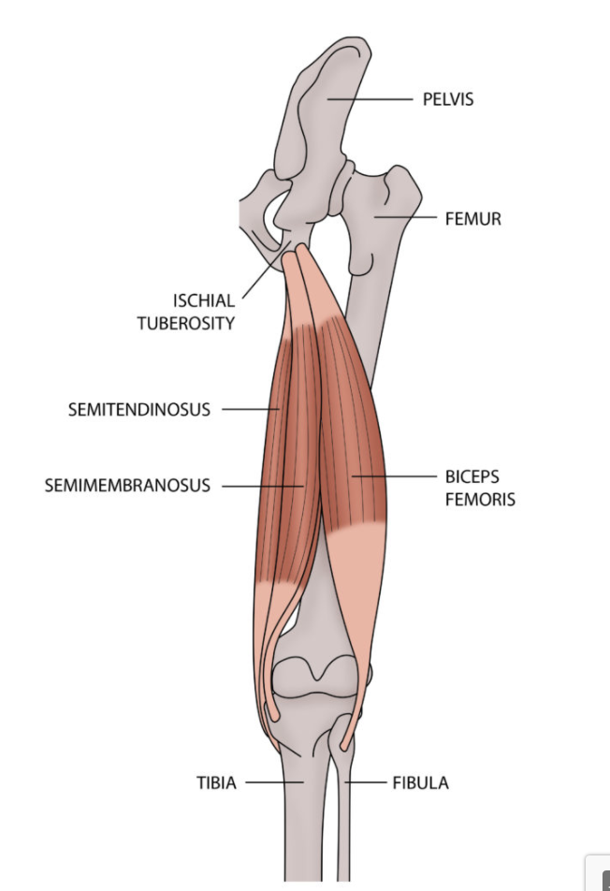
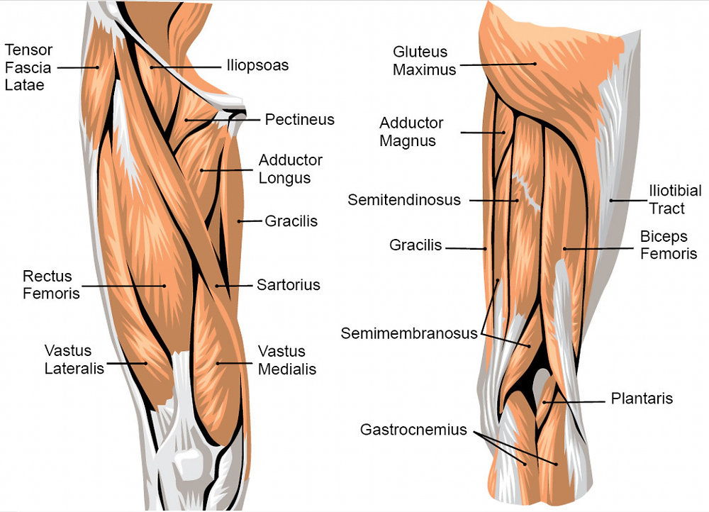
Hamstrings

Slide 5
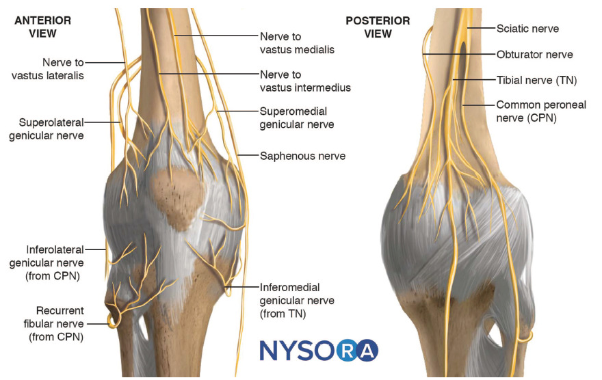
Neurovascular Structures of the Knee
Main Nerves
Femoral Nerve: Supplies quadriceps (extensors)
Sciatic Nerve: Divides into Tibial Nerve (posterior compartment of the leg) and Common Peroneal Nerve (anterior and lateral compartments of the leg)
Saphenous Nerve: Cutaneous branch of femoral nerve

Slide 6
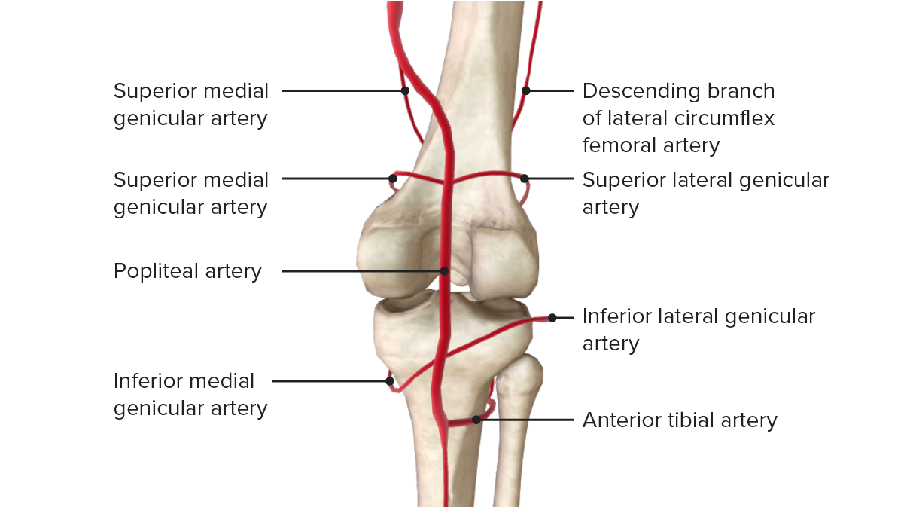
Neurovascular Structures of the Knee
Blood Supply
Arteries: Popliteal artery, genicular arteries
Veins: Popliteal vein, small saphenous vein

Slide 7
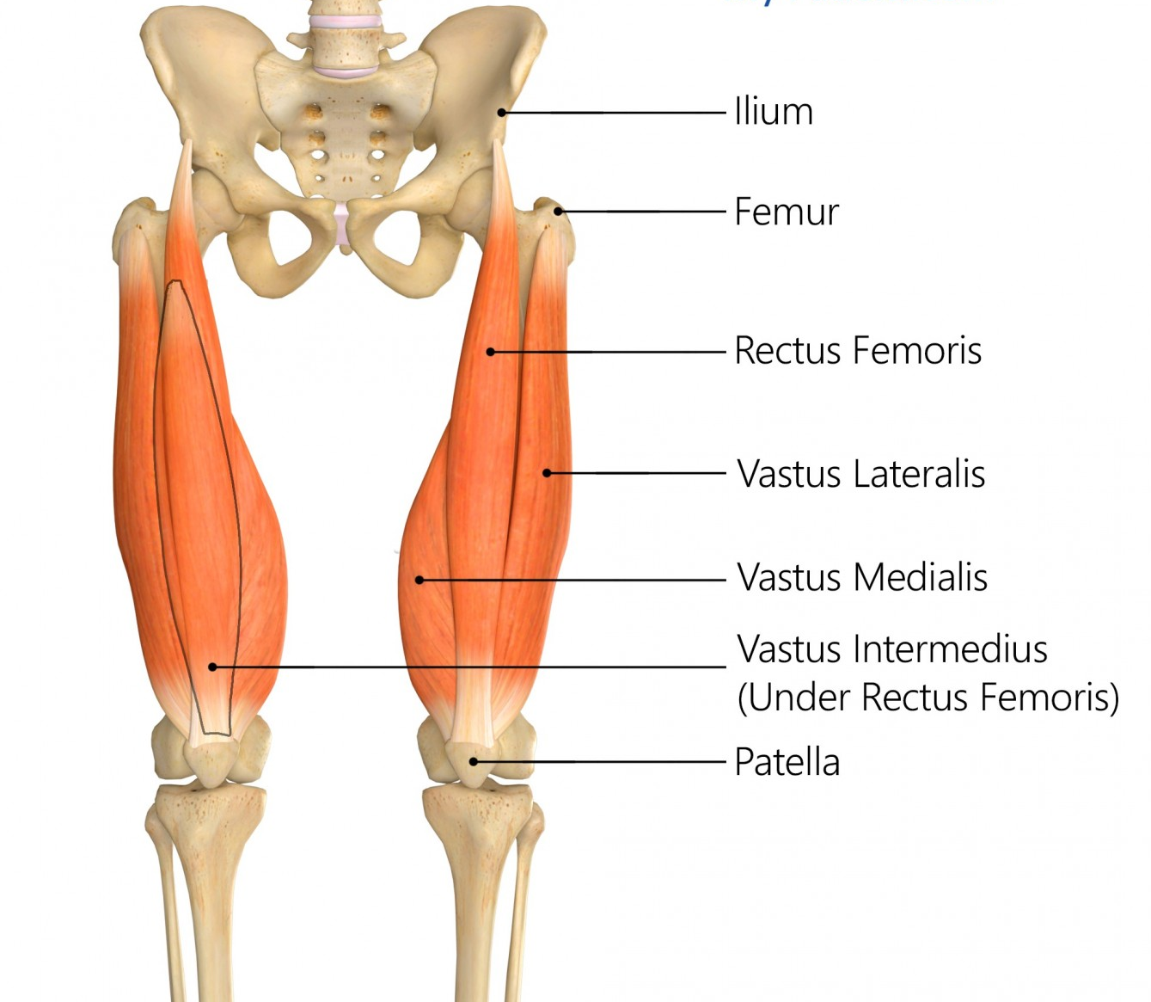
Anterior Muscles (Knee Extensors)
Quadriceps Femoris Group:
The quadriceps femoris is the primary extensor of the knee joint and consists of four muscles:
Notes:
The Quadriceps femoris is the most voluminous muscle of the human body.
The quadriceps femoris is a hip flexor and a knee extensor. It consists of four individual muscles; three vastus muscles and the rectus femoris.
They form the main bulk of the thigh, and collectively are one of the most powerful muscles in the body.
It is located in the anterior compartment of the thigh.
The four 4 sub-components are:
Rectus femoris
Vastus lateralis
Vastus medialis
Vastus intermedius
The muscles that form the quadriceps femoris unite proximal to the knee and attach to the patella via the quadriceps tendon.
In turn, the patella is attached to the tibia by the patella ligament.

Slide 8
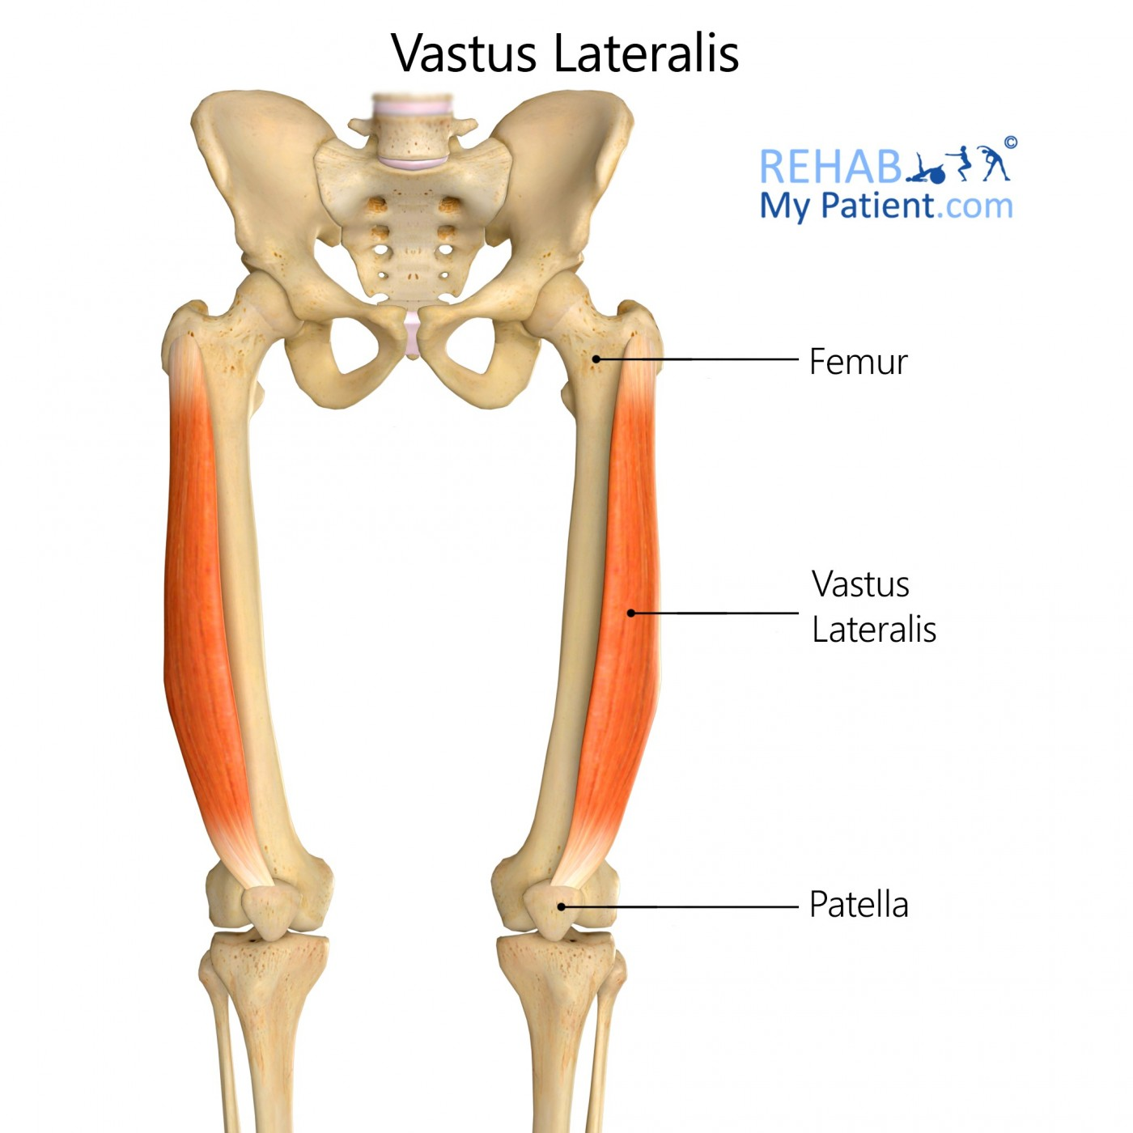
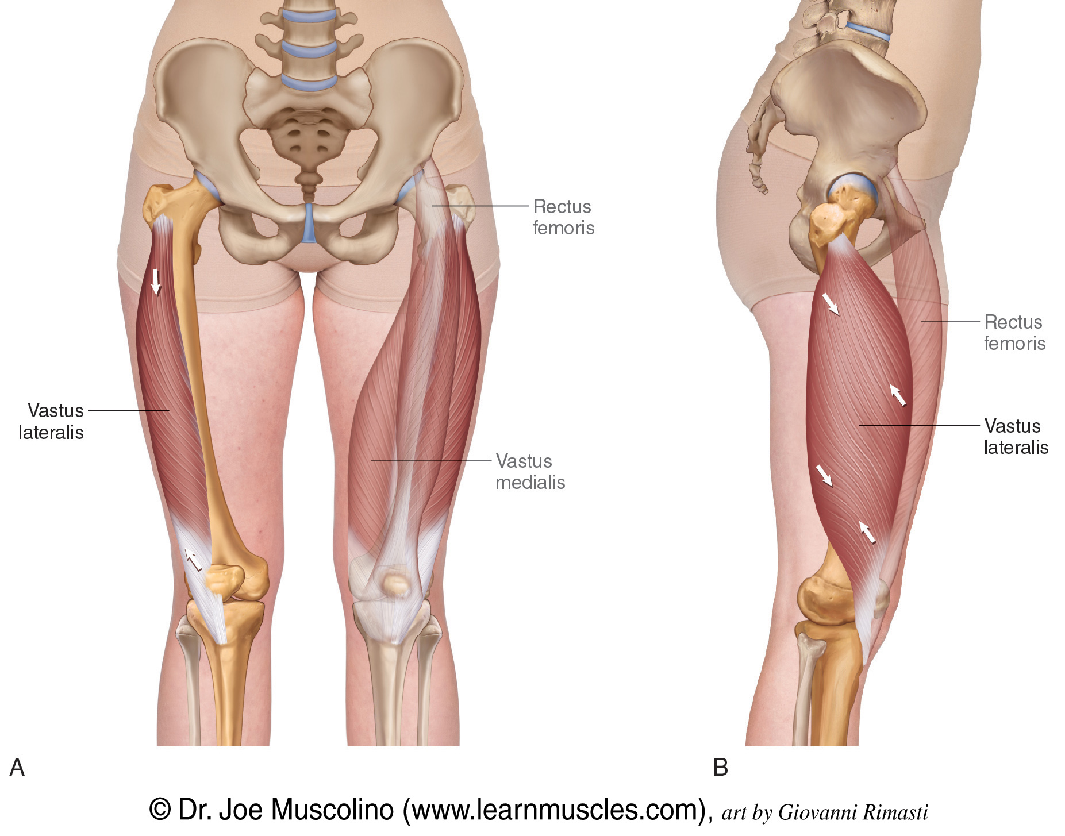
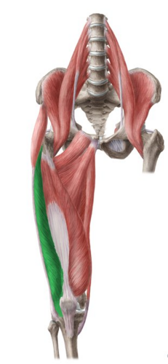
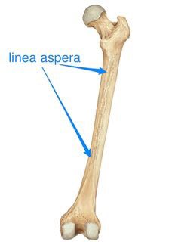
Quadriceps (Group): Vastus Lateralis
Origin:
  Greater trochanter and linea aspera of femur
Insertion:
  Tibial tuberosity via the patellar ligament
Action:
  Knee extension, patella stability
Nerve supply:
  Femoral nerve (L2-L4)
Blood supply:
  Lateral circumflex femoral artery
Clinical Relevance:
  Vastus lateralis tightness or imbalance compared to the vastus medialis can contribute to patellar tracking problems and patellofemoral pain syndrome.

Slide 9
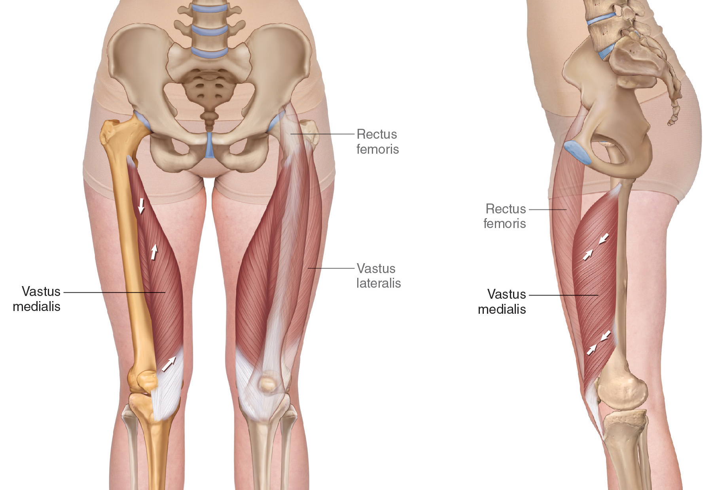
Quadriceps (Group): Vastus Medialis
Origin:
  Medial lip of linea aspera of femur
Insertion:
  Tibial tuberosity via the patellar ligament
Action:
  Knee extension, patella stability
Nerve supply:
  Femoral nerve (L2-L4)
Blood supply:
  Femoral artery, Profunda femoris artery
Clinical Relevance:
  Weakness of the vastus medialis, particularly the vastus medialis obliquus (VMO), is often implicated in patellar instability and patellofemoral pain.

Slide 10
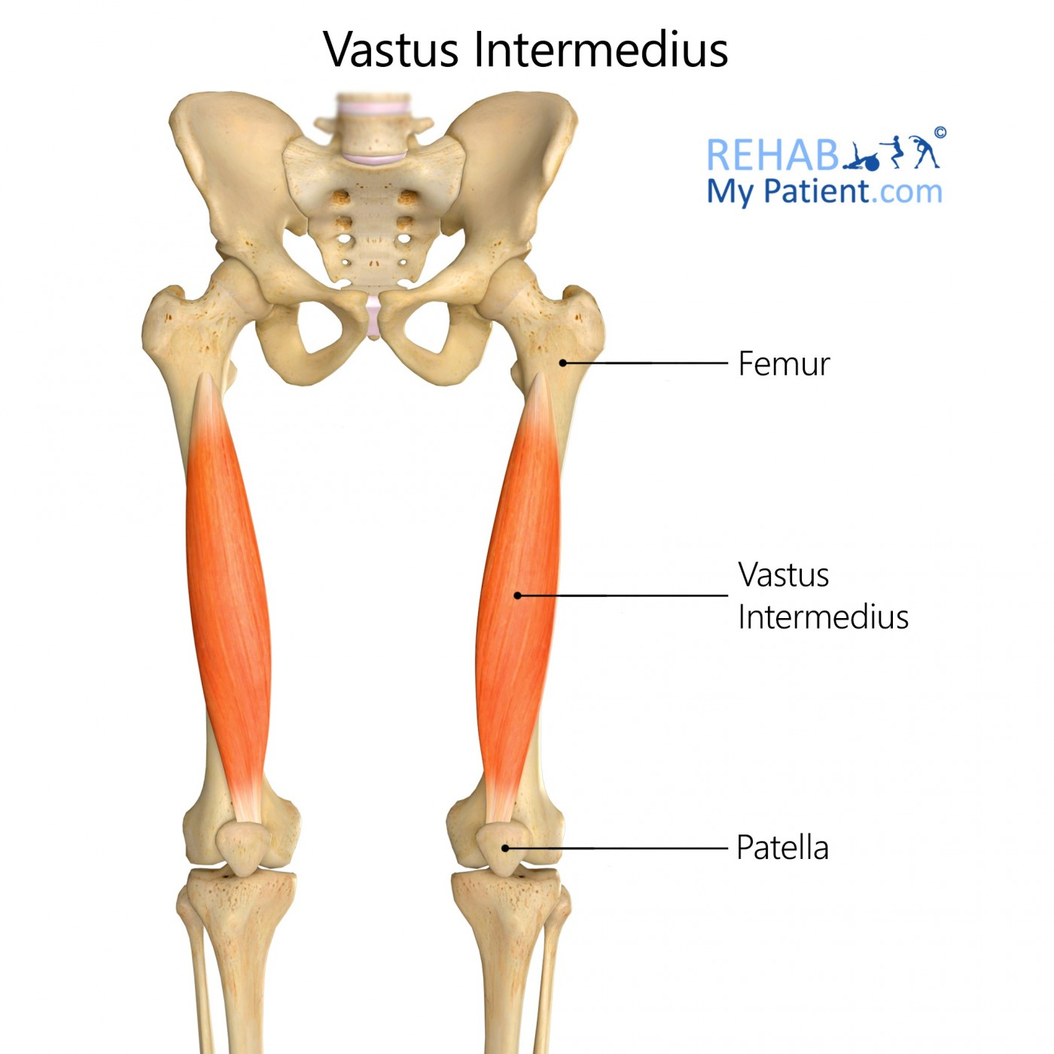
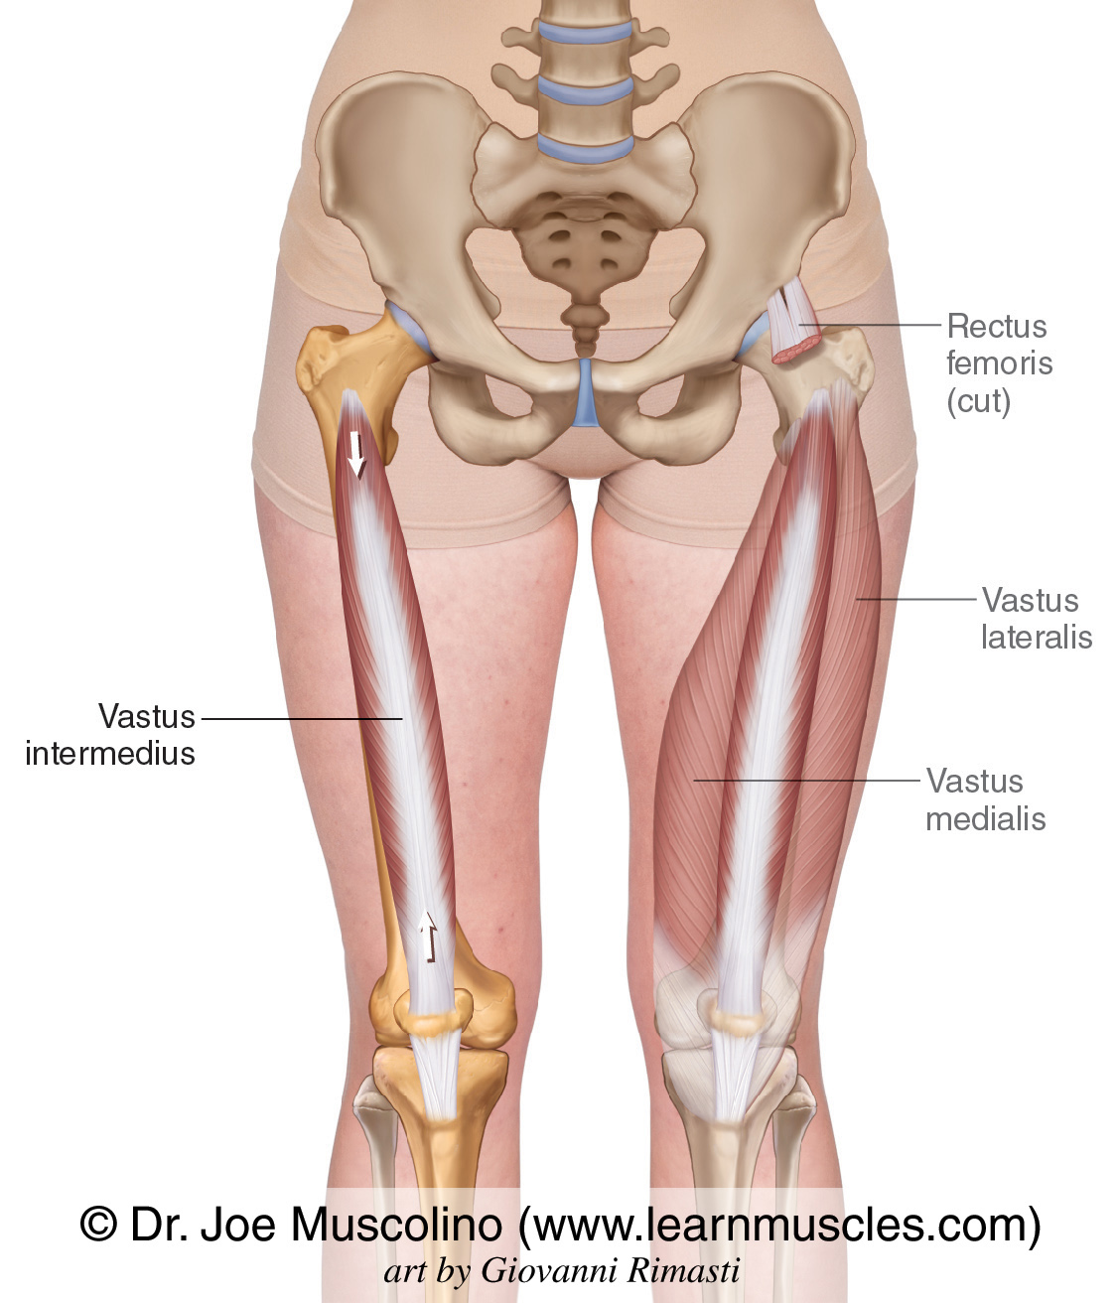
Quadriceps (Group): Vastus Intermedius
Origin:
  Anterior and lateral surfaces of the femoral shaft
Insertion:
  Tibial tuberosity via the patellar ligament
Action:
  Knee extension, patella stability
Nerve supply:
  Femoral nerve (L2-L4)
Blood supply:
  Lateral circumflex femoral artery
Clinical Relevance:
  Dysfunction of the quadriceps muscles, especially after injury or surgery, can lead to atrophy, affecting knee stability and mobility
  The Vastus intermedius lies deep to the Rectus femoris

Slide 11
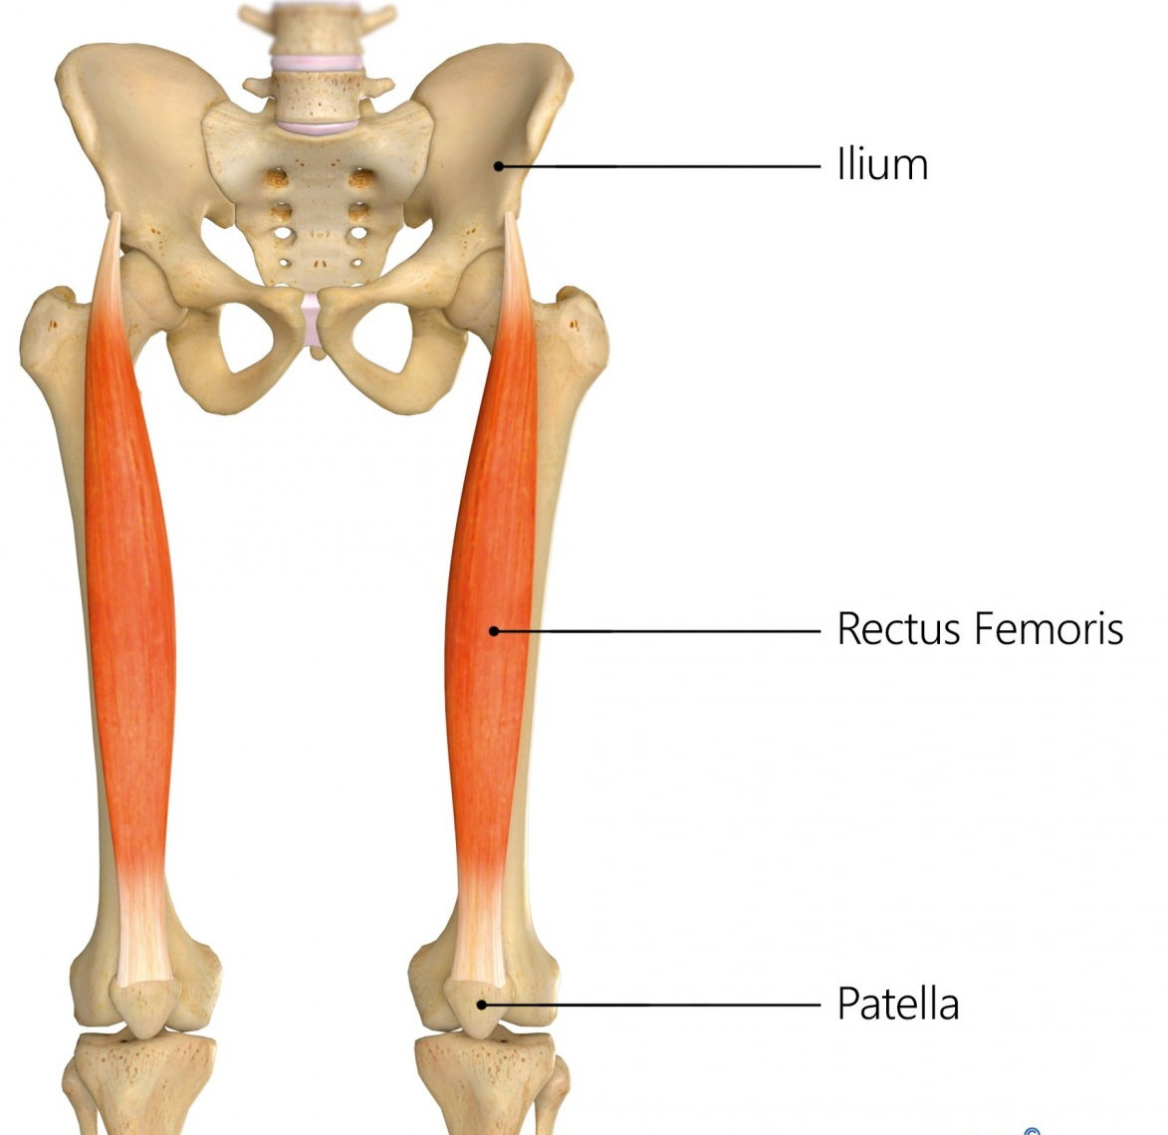
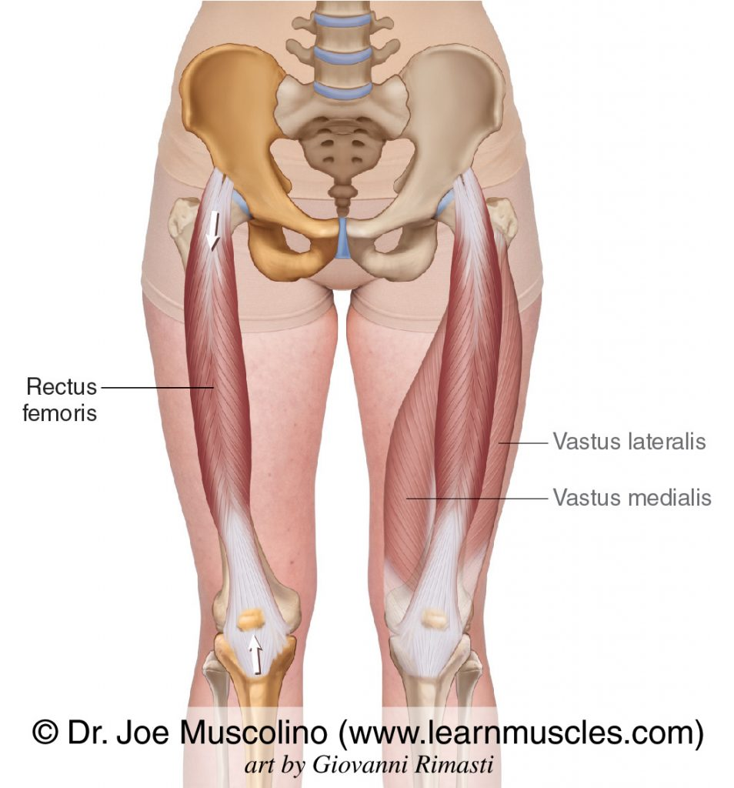
Quadriceps (Group): Rectus Femoris
Origin:
  Anterior inferior iliac spine (AIIS) and superior acetabular rim.
Insertion:
  Tibial tuberosity via the patellar ligament.
Action:
  Flexes the hip and extends the knee.
Nerve supply:
  Femoral nerve (L2-L4).
Blood supply:
  Lateral circumflex femoral artery
Clinical Relevance:
  Frequently strained in activities requiring powerful hip flexion, like sprinting or kicking.

Slide 12
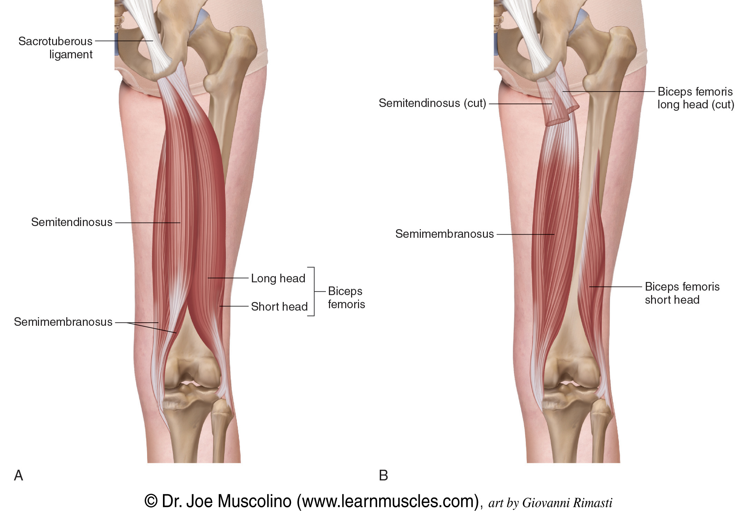
Posterior Muscles (Knee Flexors)
Hamstrings Group:
The hamstrings are the primary knee flexors and also assist in hip extension:
Notes:
The hamstrings are a group of three muscles that predominantly act to flex the knee. The hamstrings consist of 3 muscles;
Semitendinosus
Semimembranosus
Biceps femoris
The muscles cross two joints and have long proximal and distal tendons, resulting in long muscle tendon junctions (MTJ). MTJs extend into the muscle bellies, overlap within the muscle belly, facilitate transmission, and dissipate forces across the MTJ during muscle contraction and relaxation.^{[1]}

Slide 13
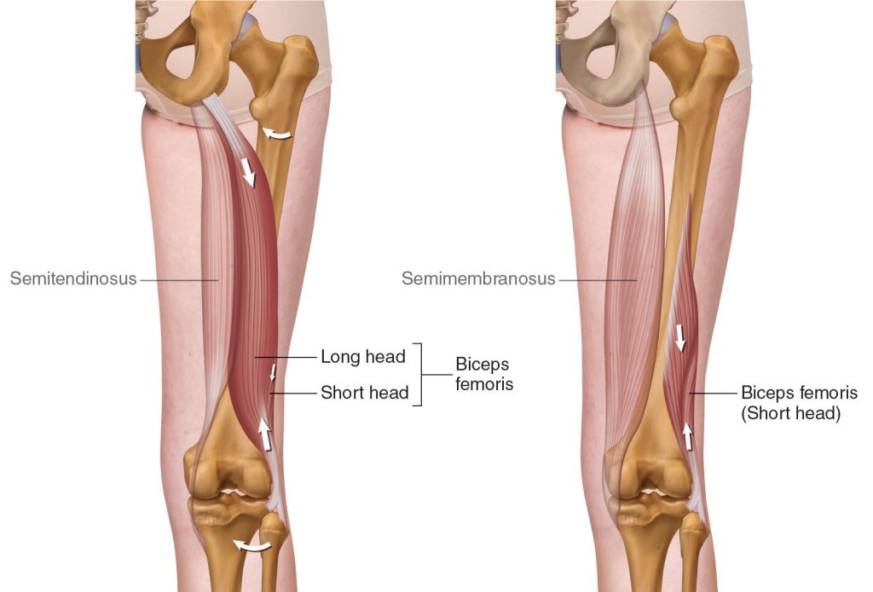
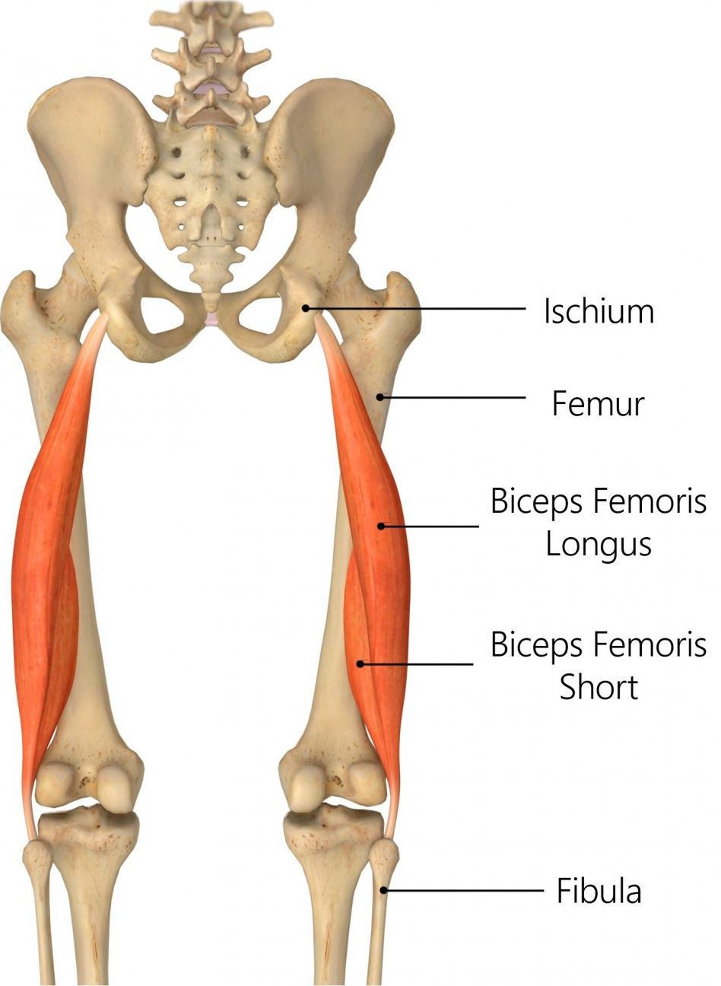
Hamstrings Group: Biceps Femoris (Long Head and Short Head)
Origin:
  Long head – ischial tuberosity;
  Short head – linea aspera.
Insertion:
  Head of the fibula.
Action:
  Flexes the knee, extends the hip, and externally rotates the knee.
Nerve supply:
  Sciatic nerve (L5-S2). (Long head: Tibial division; short head: common peroneal division)
Clinical Relevance:
  The biceps femoris is frequently injured in sprinting activities due to its role in hip extension and knee flexion.

Slide 14
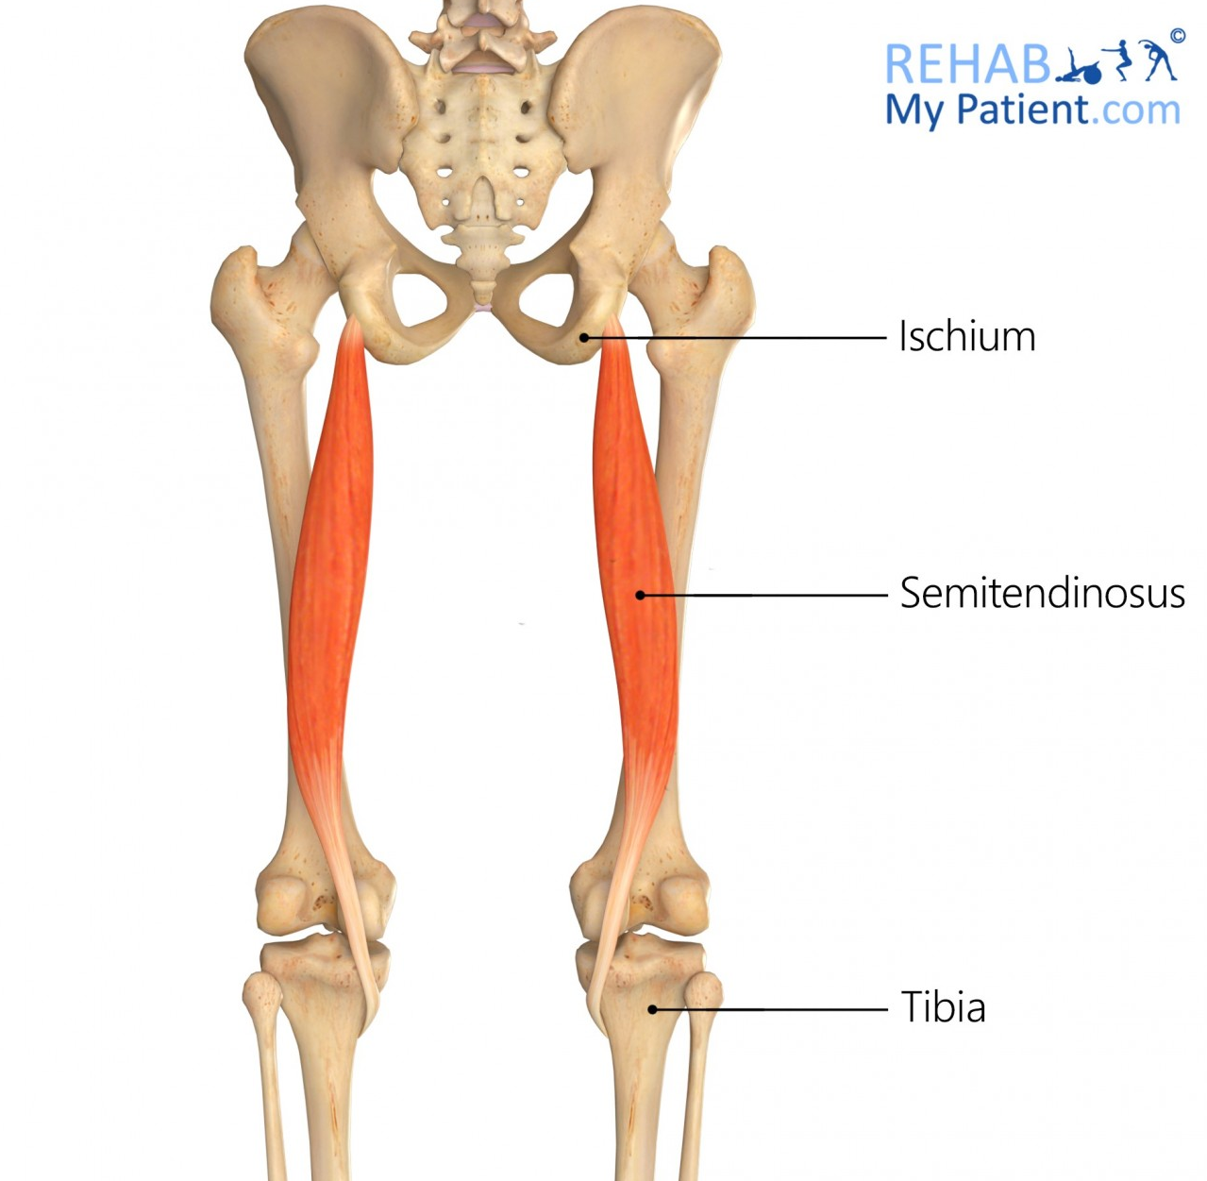
Hamstrings Group: Semitendinosus
Origin:
  Ischial tuberosity.
Insertion:
  Pes anserinus (medial surface of the tibia).
Action:
  Flexes the knee and extends the hip; internally rotates the tibia.
Nerve supply:
  Sciatic nerve (L5-S2).
Clinical Relevance:
  Often involved in hamstring strains; contributes to medial knee stability.

Slide 15
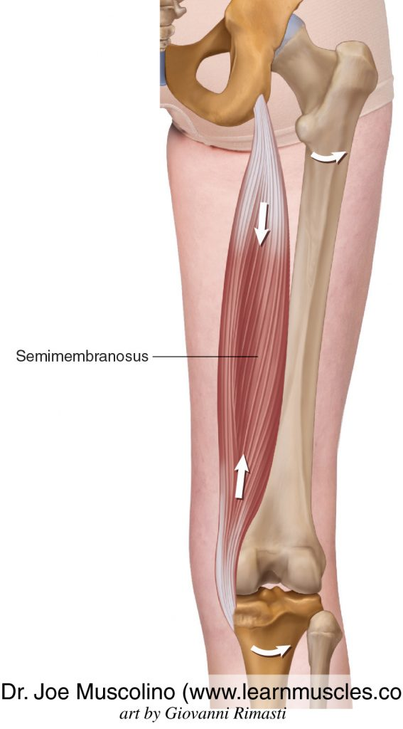
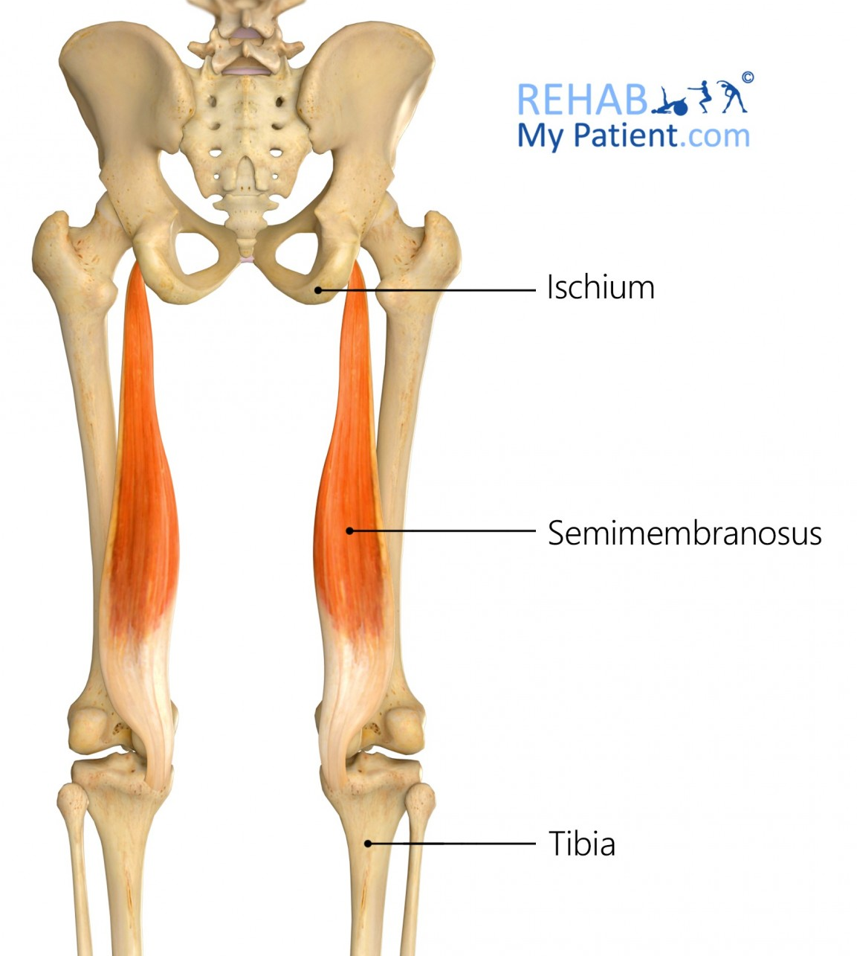
Hamstrings Group: Semimembranosus
Origin:
  Ischial tuberosity.
Insertion:
  Posterior part of the medial tibial condyle.
Action:
  Flexes the knee, extends the hip, and internally rotates the tibia.
Nerve supply:
  Sciatic nerve (L5-S2).
Clinical Relevance:
  Important in providing medial stability to the knee joint.
  Semimembranosus lies deep to the Semitendinosus and Biceps femoris
Notes:
Origin
A strong membranous tendon attaches to the upper lateral facet on the rough part of the ischial tuberosity.
Insertion
The anatomy of the distal insertion of the semimembranosus can be described as the distal semimembranosus complex: in fact, six different semimembranosus insertions can be identified. Anatomic dissection revealed six insertions of the distal semimembranosus tendon: direct arm, anterior arm, posterior oblique ligament extension, oblique popliteal ligament extension (capsular arm), distal tibial expansion (popliteus aponeurosis), and meniscal arm (De Maeseneer., 2014).

Slide 16
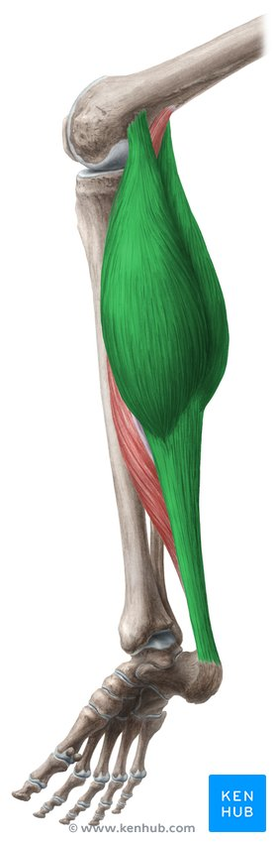
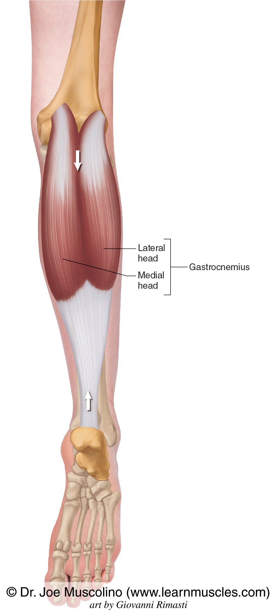
Gastrocnemius
Origin:
  Medial (Medial head) and lateral (lateral head) condyles of the femur.
Insertion:
  Calcaneus via the Achilles tendon.
Action:
  Flexes the knee and plantarflexes the ankle.
Nerve supply:
  Tibial nerve (S1-S2).
Clinical Relevance:
  A key muscle in lower limb propulsion, frequently involved in calf strains.

Slide 17
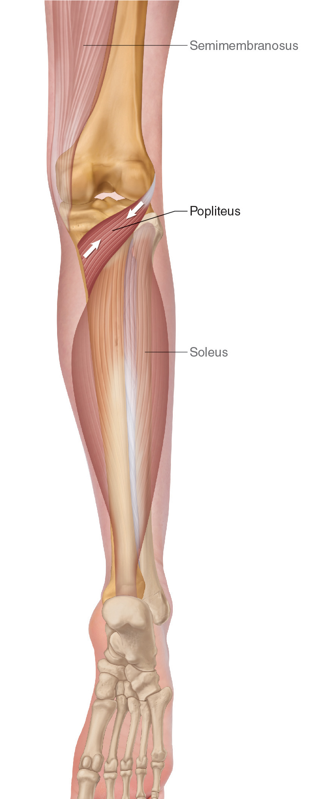
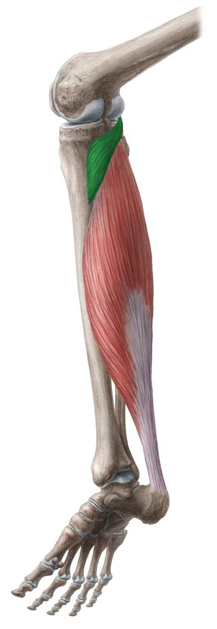
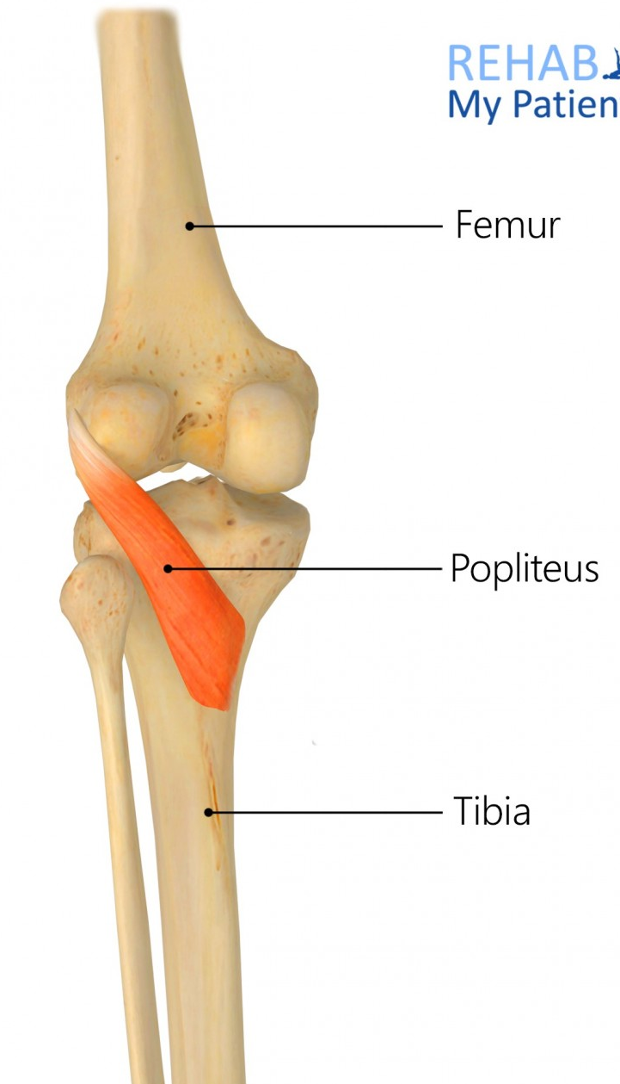
Popliteus
Origin:
  Lateral femoral condyle.
Insertion:
  Posterior surface of the tibia above the soleal line.
Action:
  Unlocks the knee by rotating the femur on the tibia; flexes the knee.
Nerve supply:
  Tibial nerve (L4-S1).
Clinical Relevance:
  Plays a crucial role in knee stability, especially in controlling knee rotation during walking.

Slide 18
Clinical Relevance of the Knee Neuromuscular structures
The balance of muscle strength between the anterior and posterior compartments of the knee is crucial for joint stability.
Imbalances, particularly between the quadriceps and hamstrings, can lead to injury or contribute to conditions such as anterior cruciate ligament (ACL) injuries, patellofemoral pain syndrome, and tendinopathies

Slide 19
Common Conditions and Injuries
Ligament tears (e.g., ACL, PCL)
Meniscal injuries
Patellofemoral pain syndrome
Knee osteoarthritis
Bursitis
Tendon injuries (e.g., patellar tendinopathy)

Slide 20

Questions

Slide 21
References
De Maeseneer M, Shahabpour M, Lenchik L, Milants A, De Ridder F, De Mey J, Cattrysse E. Distal insertions of the semimembranosus tendon: MR imaging with anatomic correlation. Skeletal Radiol. 2014 Jun;43(6):781-91
Kenhub (n.d.) Hip Anatomy and Knee Anatomy Diagrams. Available at: https://www.kenhub.com (Accessed: 14 September 2024).
McMinn, R.M.H. (2019) Last’s Anatomy: Regional and Applied. 13th edn. Elsevier Health Sciences.
Moore, K.L., Dalley, A.F. and Agur, A.M.R. (2018) Clinically Oriented Anatomy. 8th edn. Wolters Kluwer.
Muscolino, J.E. (n.d.) The Muscular System Manual: The Skeletal Muscles of the Human Body. Available at: https://www.learnmuscles.com (Accessed: 14 September 2024).
Netter, F.H. (2019) Atlas of Human Anatomy. 7th edn. Elsevier.Physiopedia (n.d.) Hip and Knee Anatomy Overview. Available at: https://www.physio-pedia.com (Accessed: 14 September 2024).
Rehab My Patient (n.d.) Anatomy of the Hip and Knee. Available at: https://www.rehabmypatient.com (Accessed: 14 September 2024).
Standring, S. (2020) Gray’s Anatomy: The Anatomical Basis of Clinical Practice. 42nd edn. Elsevier.

